Slide 1
Radiology Protocol Tool & Reporter (RAPTOR) Milestone #3 Review
SAN Business Consultants
June 23, 2014

Slide 2
Milestone #3 Agenda
Overview – Project Definition and Approach
Milestone #1 review completed
Milestone #2 review completed
Changes in the Innovations Sandbox
Series of SME meetings
User Acceptance Testing prep
Risk Log
Questions & Demo

Slide 3
Project Definition
Improve the safety, quality and efficiency of the protocol and ordering workflow
Evolve the prototype into the RAPTOR application in 18 months
Visual Design & Theme
Technical Implementation
Testing and Launch

Slide 4
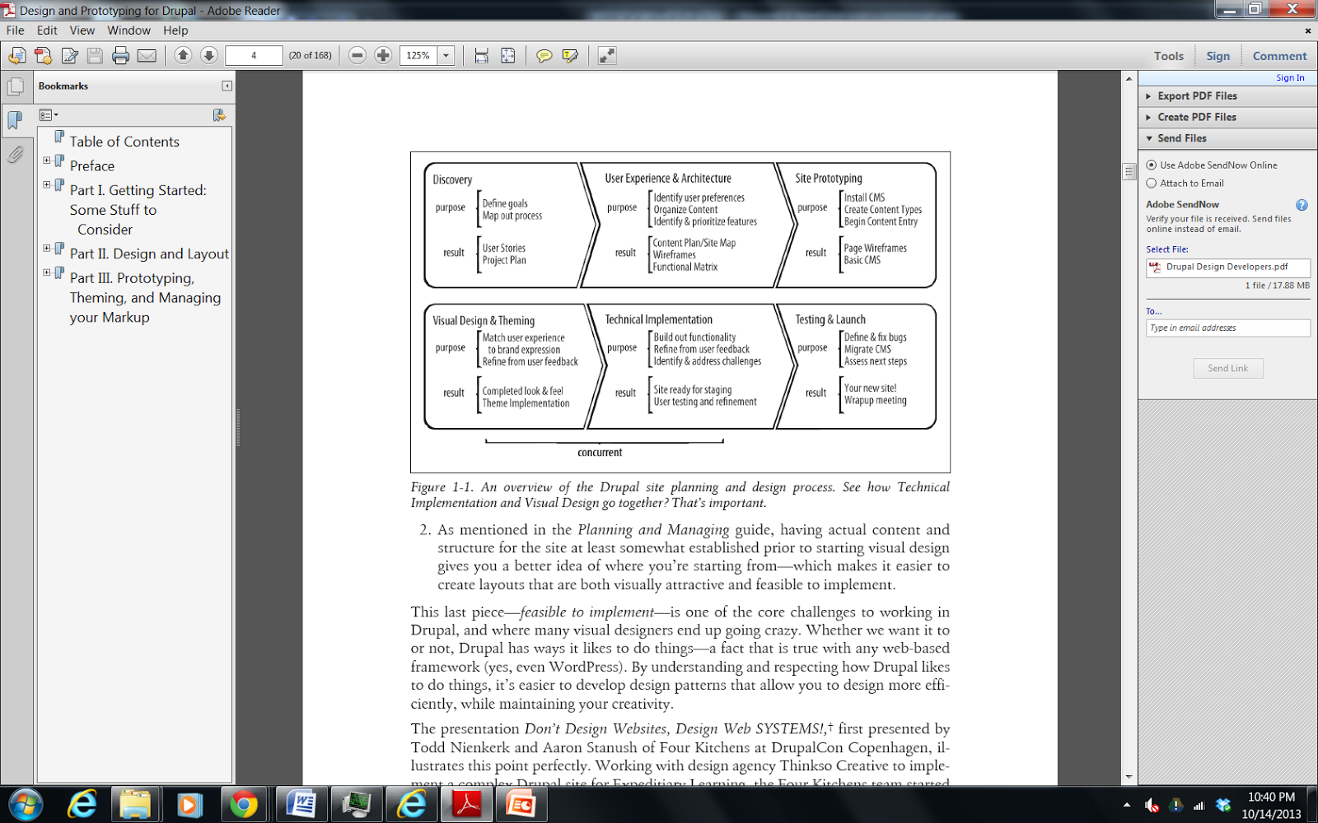
Approach of project
From Designing and Prototyping in Drupal, D. Nordin, 2012

Slide 5
SME meetings
We have held a series of functional meetings:
Requirements gathering
Understanding workflow & user experience
Functional demonstration
UAT preparation
Enhancement review

Slide 6
Milestone #1: Dec 23,2013
Increment #1 submitted on time included:
Style Sheets and theme images of new worklist and prototype screens
Contraindication Engine Architecture
Worklist Item Ranking
Worklist Processing Modes
Site Map
UI Guide
Ranking Algorithm
PM Plan, v.1.2

Slide 7
Innovations Sandbox
Virtual Testing Environment
SAN created and populated advanced imaging test data and installed the data loader into the sandbox
Migrated from cloud1 (VMware view client) to cloud2 (Amazon) last release
Installed VIX and Imaging Database
36 tickets total

Slide 8
Milestone #2:March 23,2014
Increment #2 submitted on time included:
RAPTOR in cloud2
Demonstration of 18 enhancements including worklist and protocol functionality
UAT Plan
UAT Cases
Updated Technical Documents

Slide 9
Milestone #3:June 23,2014
Increment #3 submitted on time included:
Demonstration of 21 enhancements including user management, & workflow functionality
UAT Plan
UAT Cases
Updated Technical Documents

Slide 10
Scheduled Milestones
December 2013 – Theme and Worklist
March 2014 – Templates, UI connected to database
June 2014 – User Management, Workflow
(4) Functional Sprints through December
October 2014 – Site ready for staging
January 2015 – Final UAT
March 2015 – Deployment & Assess next steps

Slide 11
Risk #9: Production Support of VA Software
Date Initially Logged: December 28, 2013
Type: Production
Issue: Lack of production support and knowledge of MDWS, VIX and CVIX. Closest MDWS and VIX installations are reportedly thousands of miles away from Sacramento CA.
Mitigation: RAPTOR servers will have to have VIX and MDWS installed. Developers request to have access to servers.

Slide 12

Questions

Slide 13
Production Hardware
SAN provided HW specs for verification
Open Issues Include
1. Confirm version of VA workstation browser is IE9 and is running on Windows 7
2. Schedule monthly touch point meetings between the RAPTOR Team and RO1 OIT PM
3. Jacqui to write up RO1 Data Center Requirements
4. Provide information requested by development team on data center procedures, backup, etc.
5. VA will support all of the Data Center installation. SAN will not be admitted to the data center hence no travel to Sacramento is required. How will communication be facilitated?
6. Does production support and knowledge include Imaging Architecture (VIX)?
8. The PWS doesn’t mention switch. Is the expectation that SAN should include this?
9. Clarify PWS requirement - are both fiber or Ethernet channels required?

Slide 14
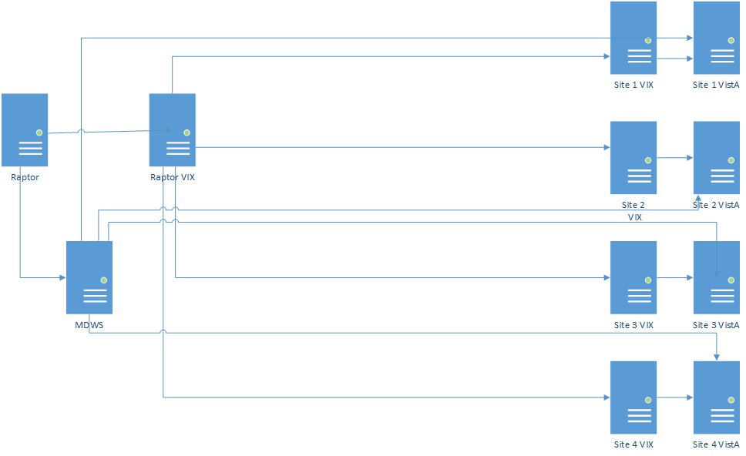
Physical Architecture
Sacramento Data Center

Slide 15
Worklist Page Demo
Worklist Columns can be hidden
Additional (Modality, Scheduled) & rearranged columns
Rows are managed to minimize scrolling
Adding Schedule info
Sorting

Slide 16
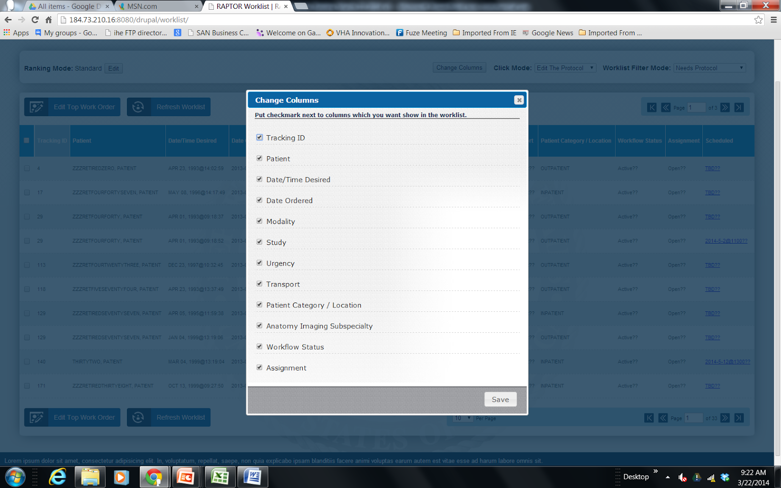

Slide 17
Dashboard Page
Templates Concept
Auto-populate fields
Contraindication details
Suspend/ Reserve

Slide 18
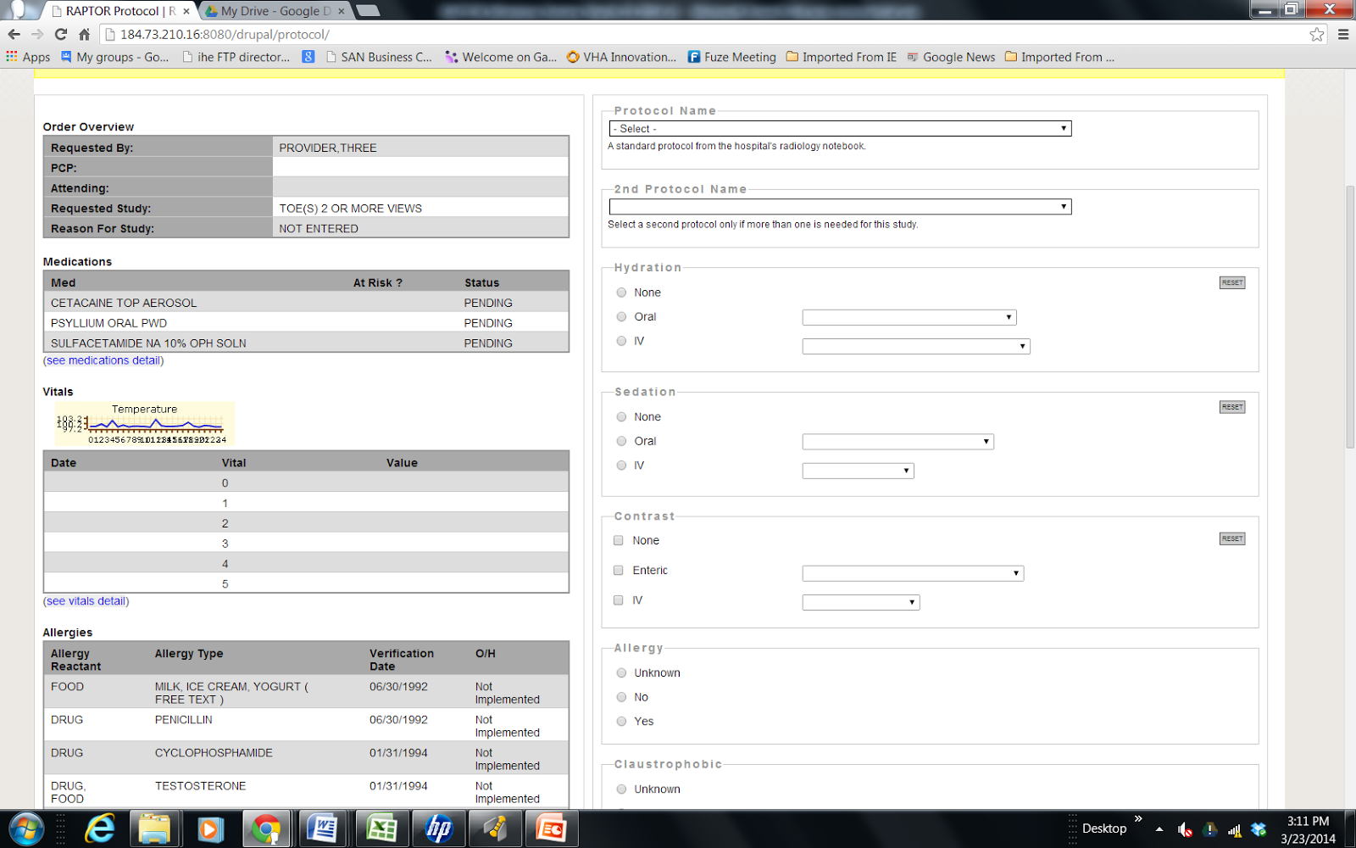
Template Concept

Slide 19
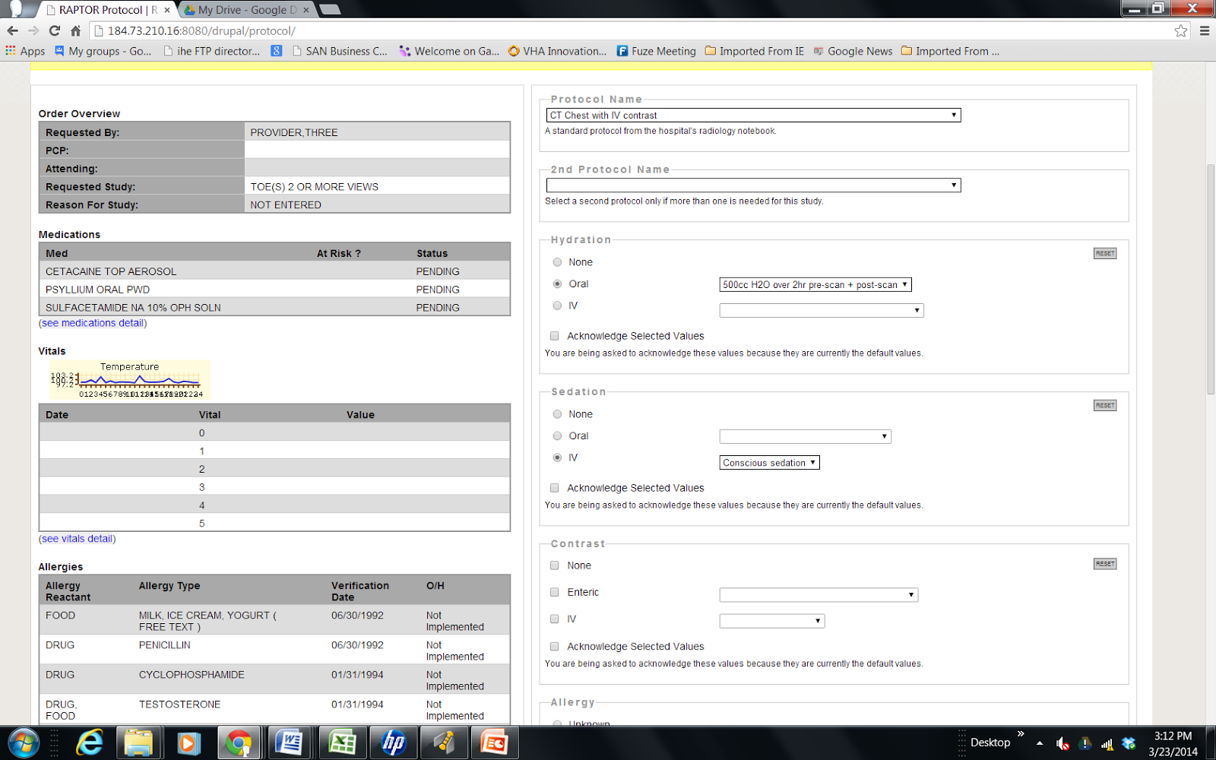
Auto-populate fields

Slide 20
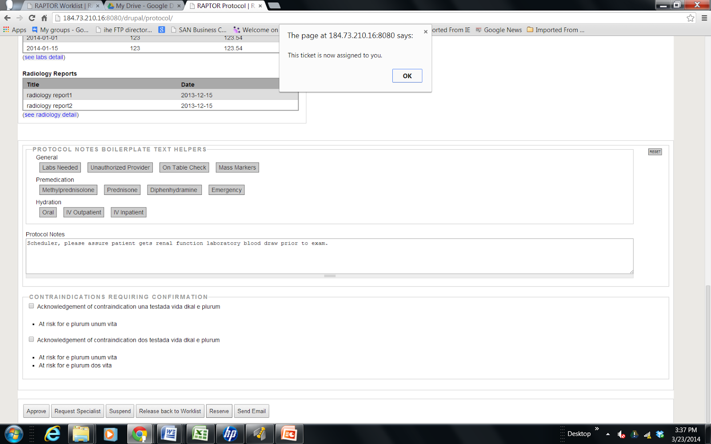
Reserve

Slide 21
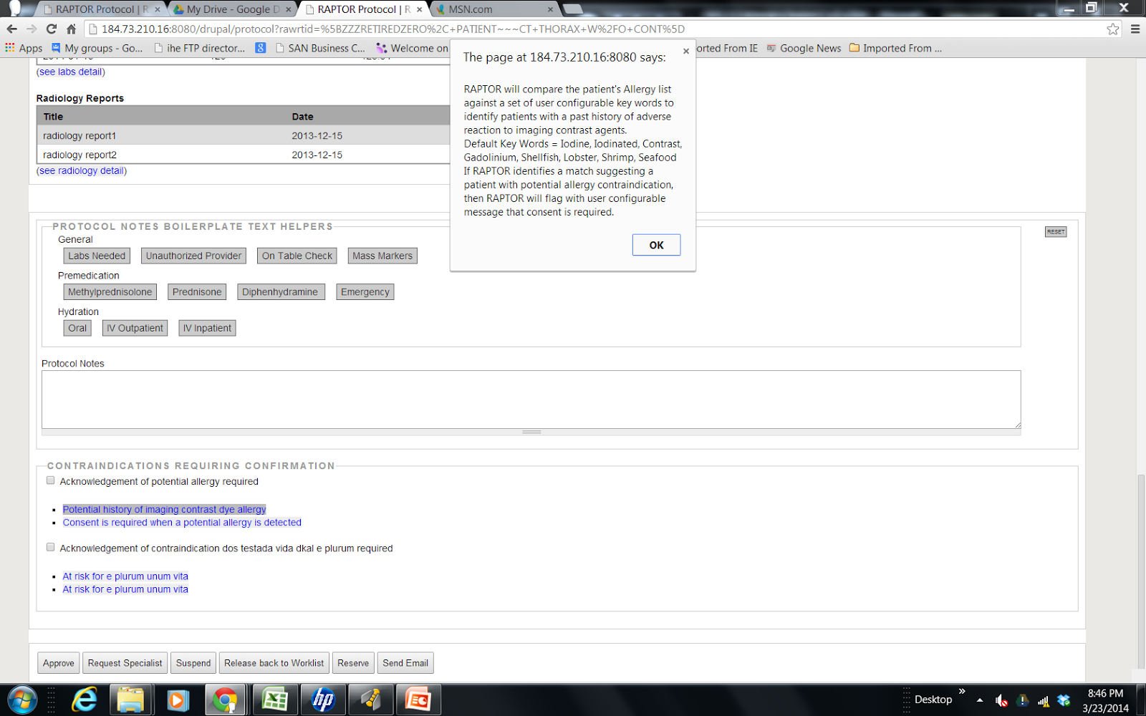
Contraindications Drill Down

Slide 22
VistA 4 Product Roadmap 2014, 5.6.2 Radiology
Additional new (radiology) capabilities will consist of:
• Ability to assign orders for imaging studies to radiologists so they can be protocoled;
• Select acquisition protocols for ordered and scheduled imaging studies with rationale for selection;
• Communicate imaging instructions to technologists;
• Communicate patient communications from clerk to radiologist and technologist, and;
As listed above, VistA 4 radiology will include best practices functionality such as support for electronic protocols and a dashboard display of the patient’s status, which will facilitate communication between radiologists and technologists. Incorporating protocols within radiology procedures will ensure that important safety information such as allergies and renal functions are clearly communicated.

Slide 23
Scheduler Workflow Demo #1
Today’s RAPTOR demo will follow Seattle’s workflow.
Workflow will progress from Scheduler to Resident to Radiologist to Technologist
User access/verify codes are from VistA and validated in RAPTOR
Scheduler assigns CTs but not MRs. RAPTOR can handle workflow where protocoling doesn’t begin until scheding has occured. Scheduler will logon, review filtered worklist for highest priority CT orders. Scheduler will use RAPTOR to assign and add notes for two different studies to Resident (443 shows descending vitals data and 2005 to show image). Scheduler accidentally double books room and error message is displayed. Patient communications are captured. The Scheduler cancels another exam, based on patient request. Scheduler logs off.
Notes:
Scheduler = 01vehu/vehu01

Slide 24
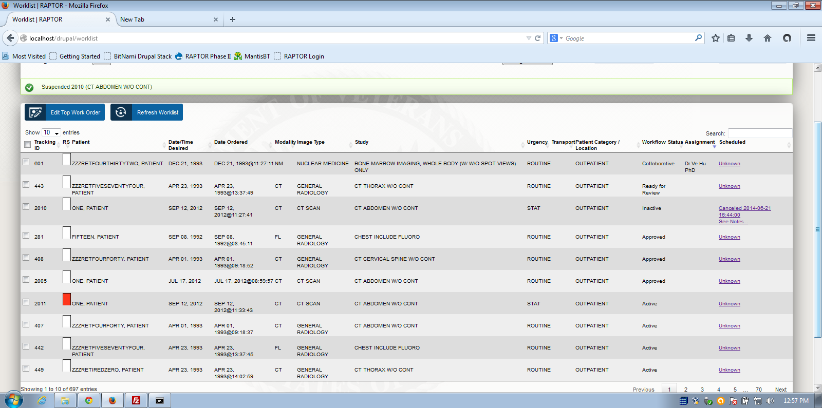
Workflow Status = Active, Inactive, Collaborative, Ready for Review, Acknowledged, Approved

Slide 25
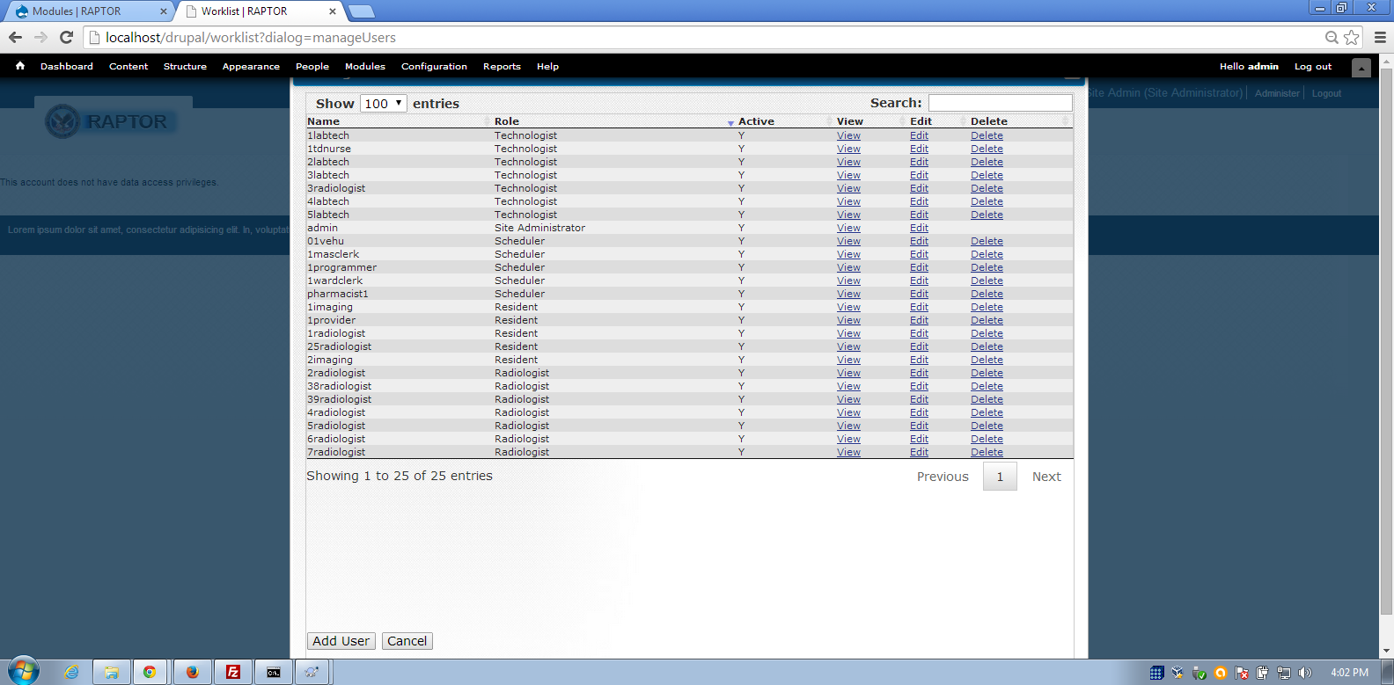

Slide 26
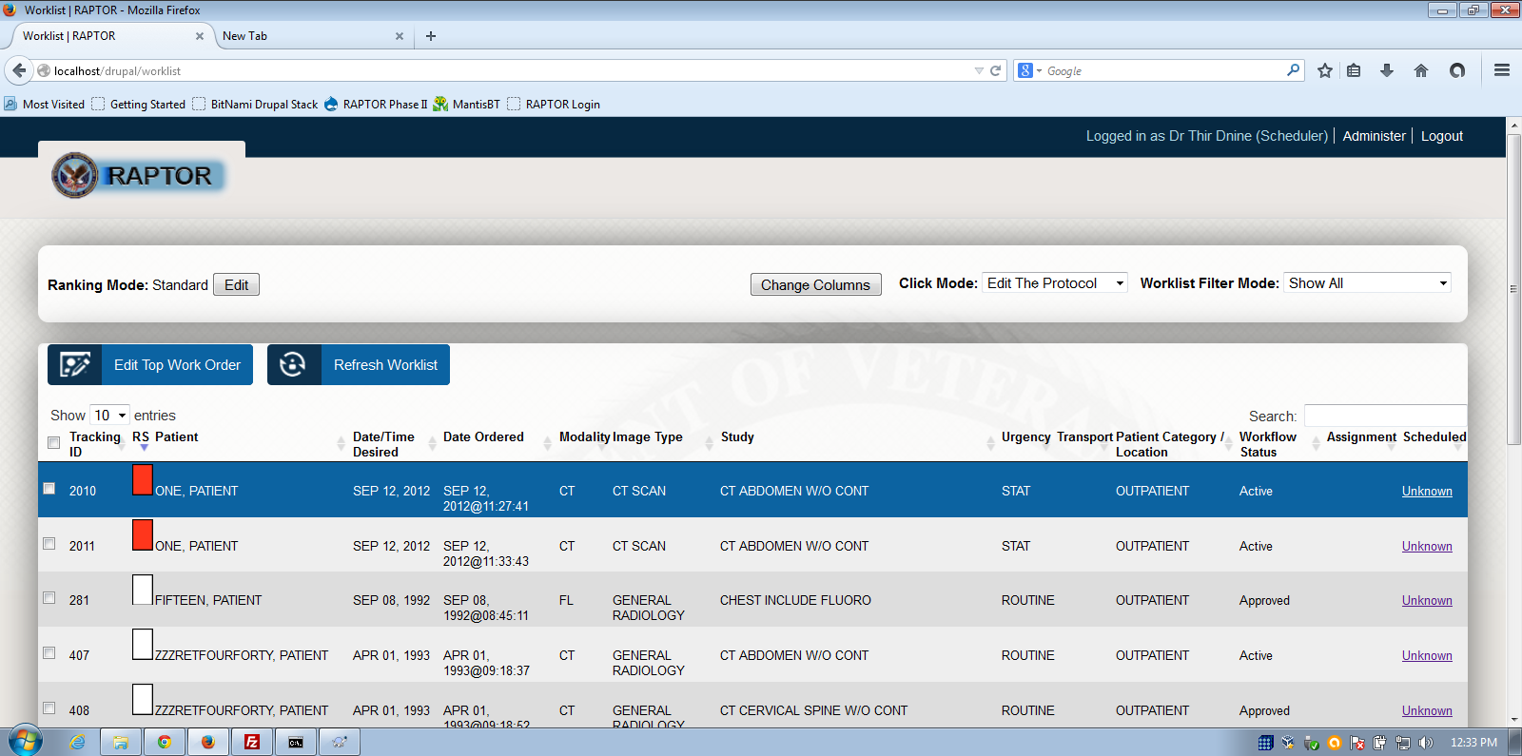
Scheduler, Ranking Score

Slide 27
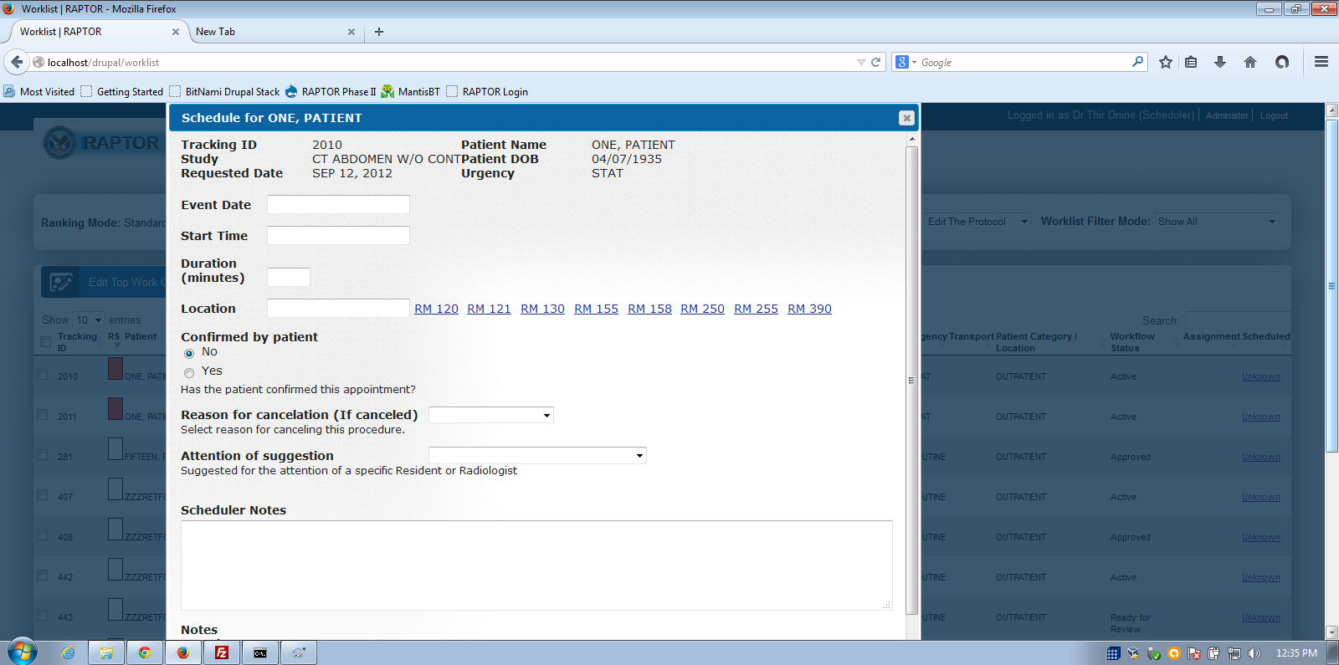
Schedule

Slide 28
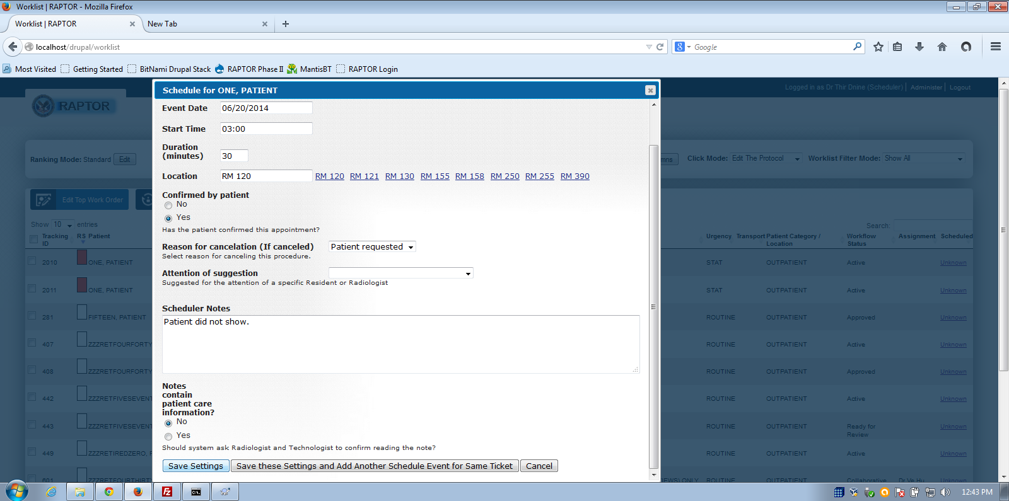
Patient Initiated Cancel

Slide 29
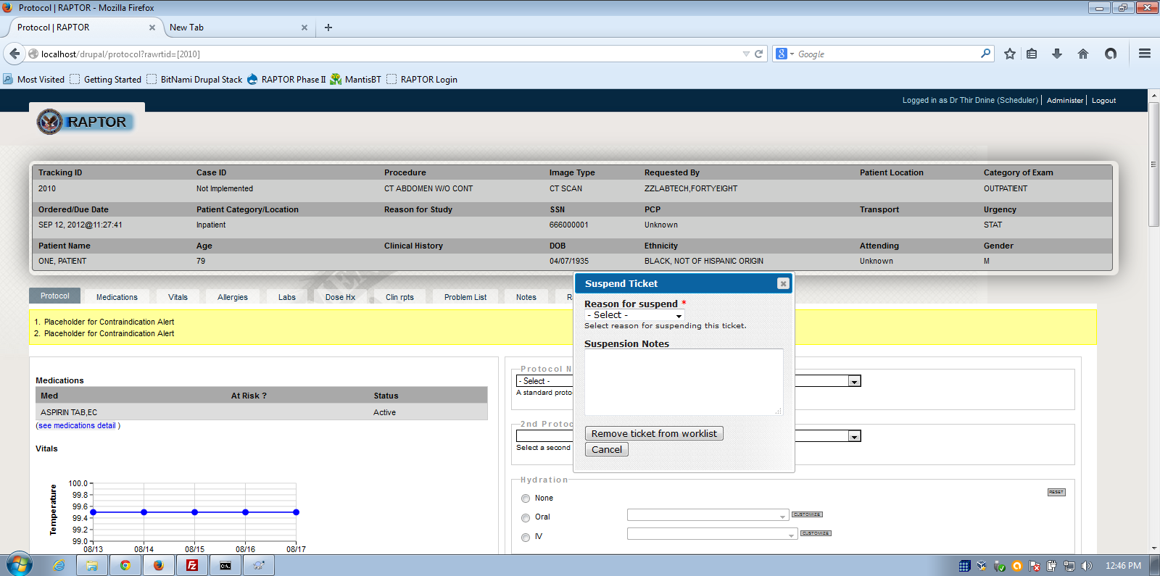
Ticket Suspended

Slide 30
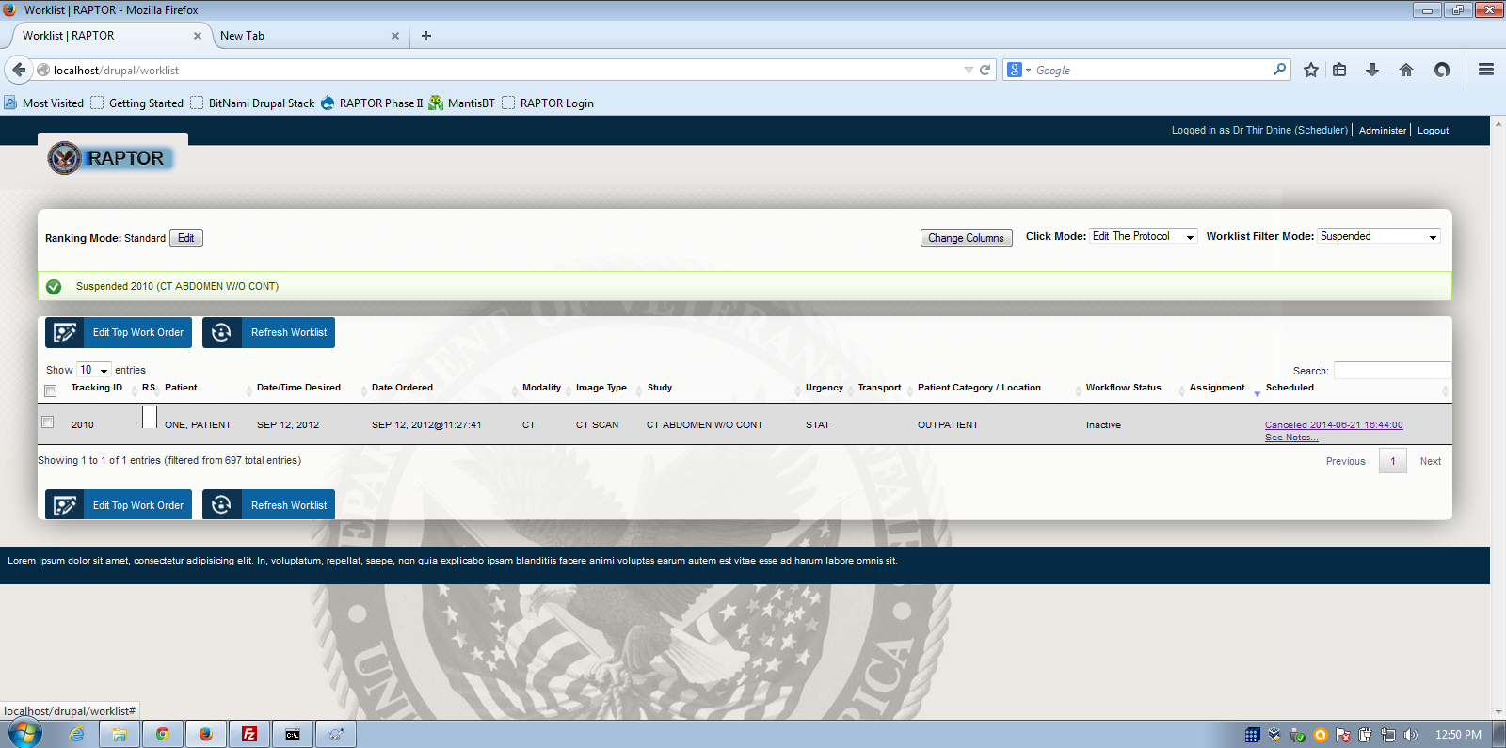

Slide 31
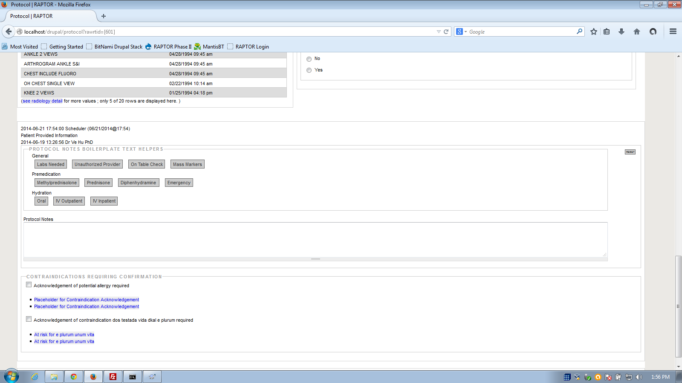
Scheduler Notes to Radiologist

Slide 32
Resident Workflow Demo #1
Resident will log on and reviews worklist and sees assignment. Resident selects these two for personal list, so one item follows the other. For each, Resident reviews scheduler notes. Two studies assigned are reviewed and protocoled (443 CT Thorax, 2005 CT Abdomen w/o contrast) and prepped for the Radiologist to review and sign. Resident selects request approval. Writes note (using mass marker note) Technologist, please ask patient where mass is and then bracket mass with skin surface markers prior to scanning. Resident logs off.
Notes:
Resident = 1radiologist/radiologist1!

Slide 34
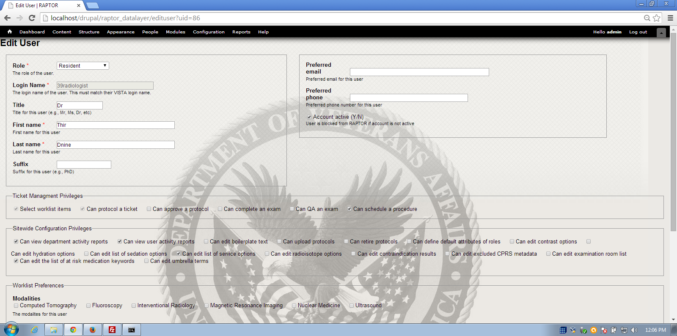
Resident

Slide 35
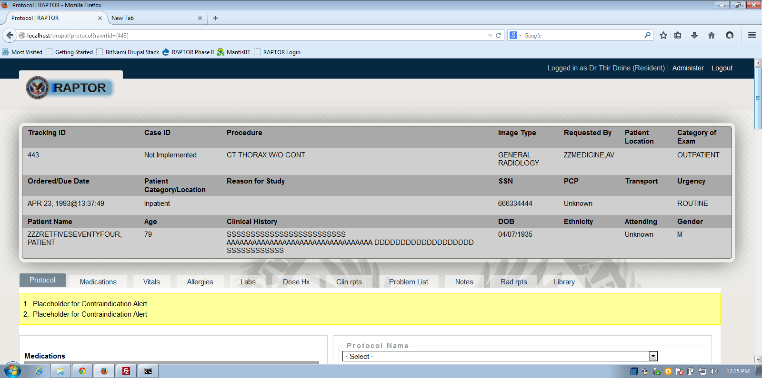
Resident

Slide 36
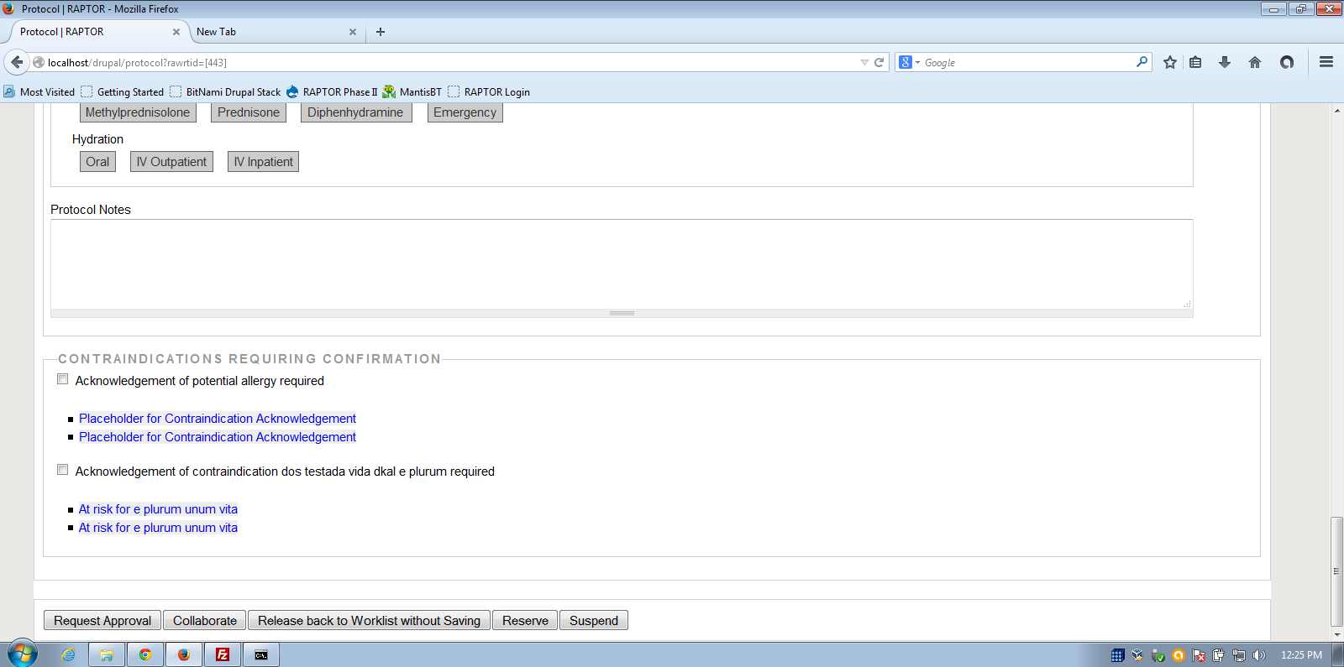
Resident Request Approval

Slide 37
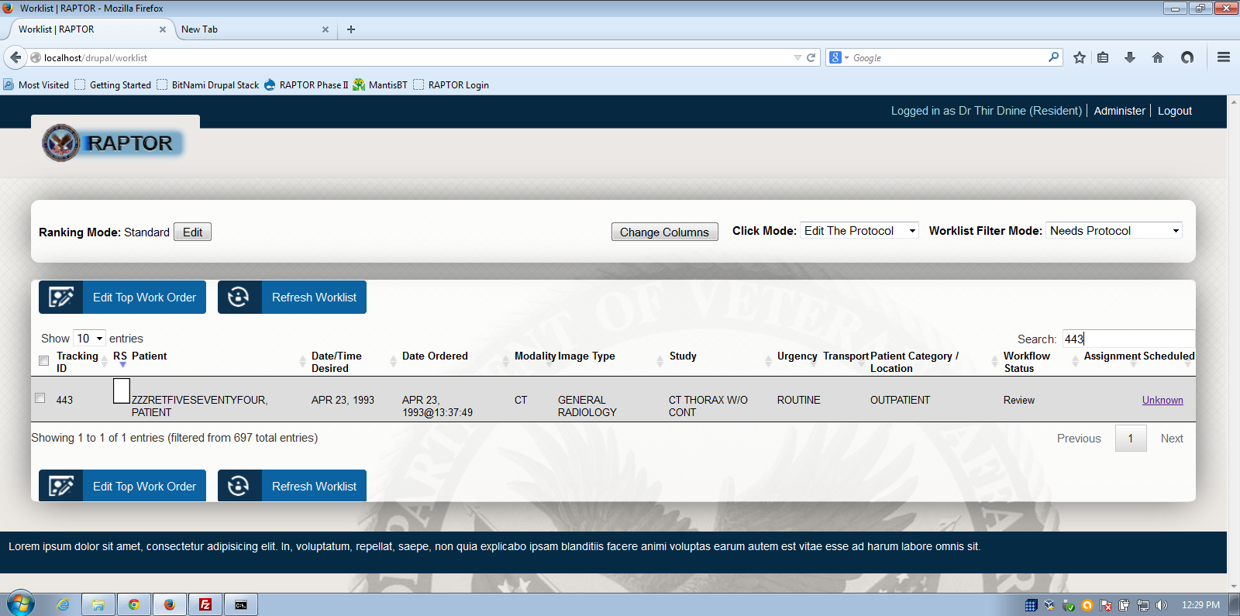
Workflow status = Review

Slide 38
Workflow Demo #2
Radiologist logs on and reviews worklist and sees collaboration. Radiologist selects these two for personal list, so one item follows the other. For each, Radiologist reviews scheduler notes. Two studies assigned are reviewed and protocoled (443 CT Thorax, 2005 CT Abdomen w/o contrast). Radiologist makes changes and writes note. Radiologist signs and logs off.
Technologist logs on and reviews worklist and sees approved items. Technologist reviews work and acknowledges.
User Management customization and demonstration
Notes:
Radiologist = 2radiologist/radiologist2! Technologist = 3radiologist/radiologist3!

Slide 39
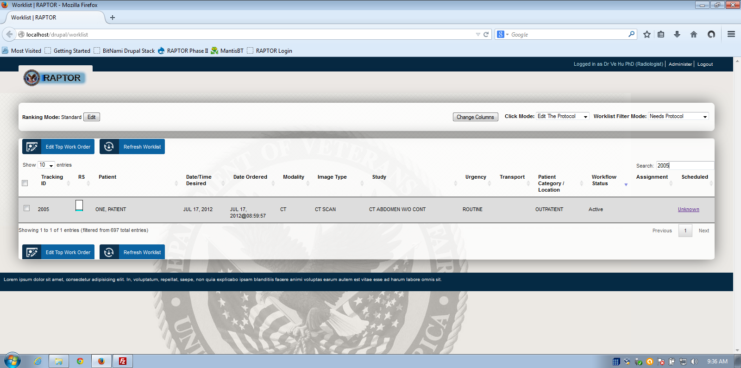
Radiologist searches worklist

Slide 40
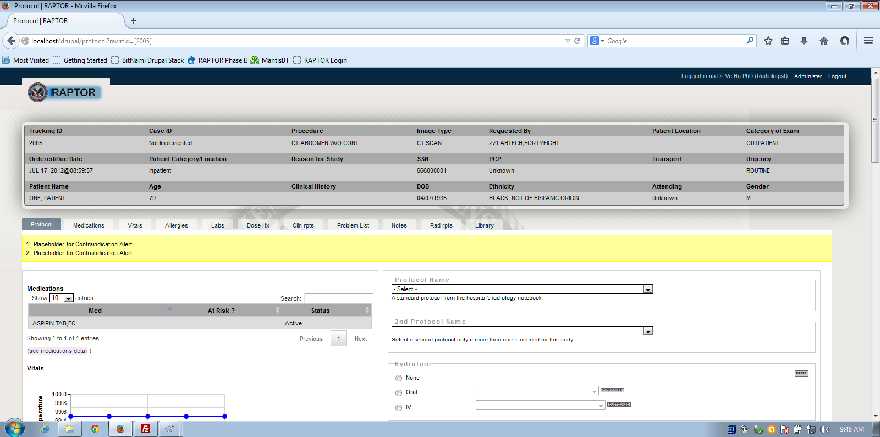
Radiologist selects

Slide 41
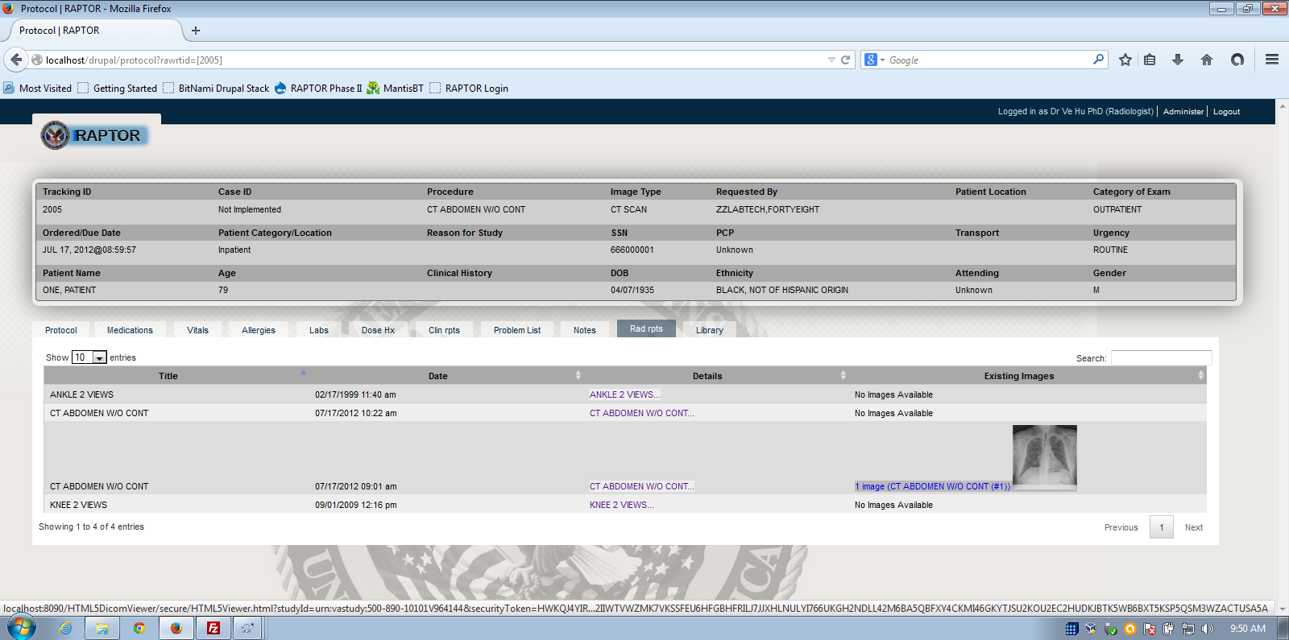
Radiologist Reviews Rad Reports and Images

Slide 42
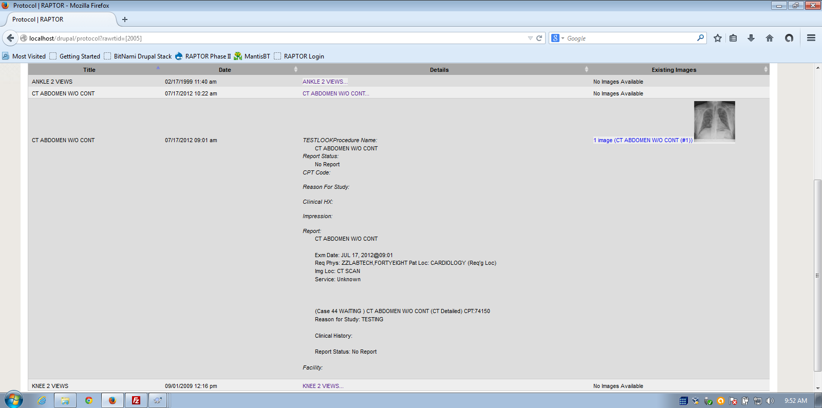
Report Details

Slide 43
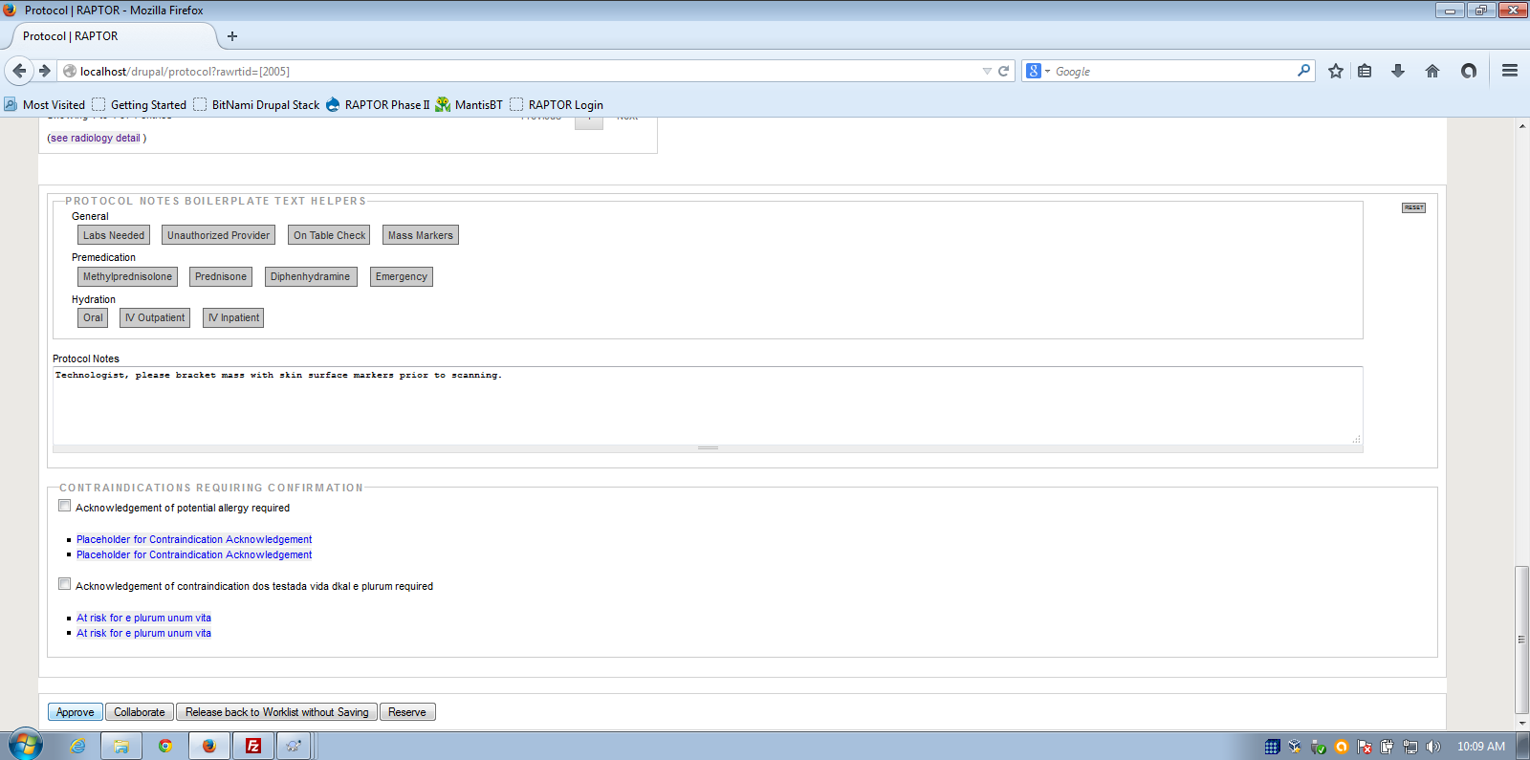
Radiologist uses text helpers to send note to technologist

Slide 44
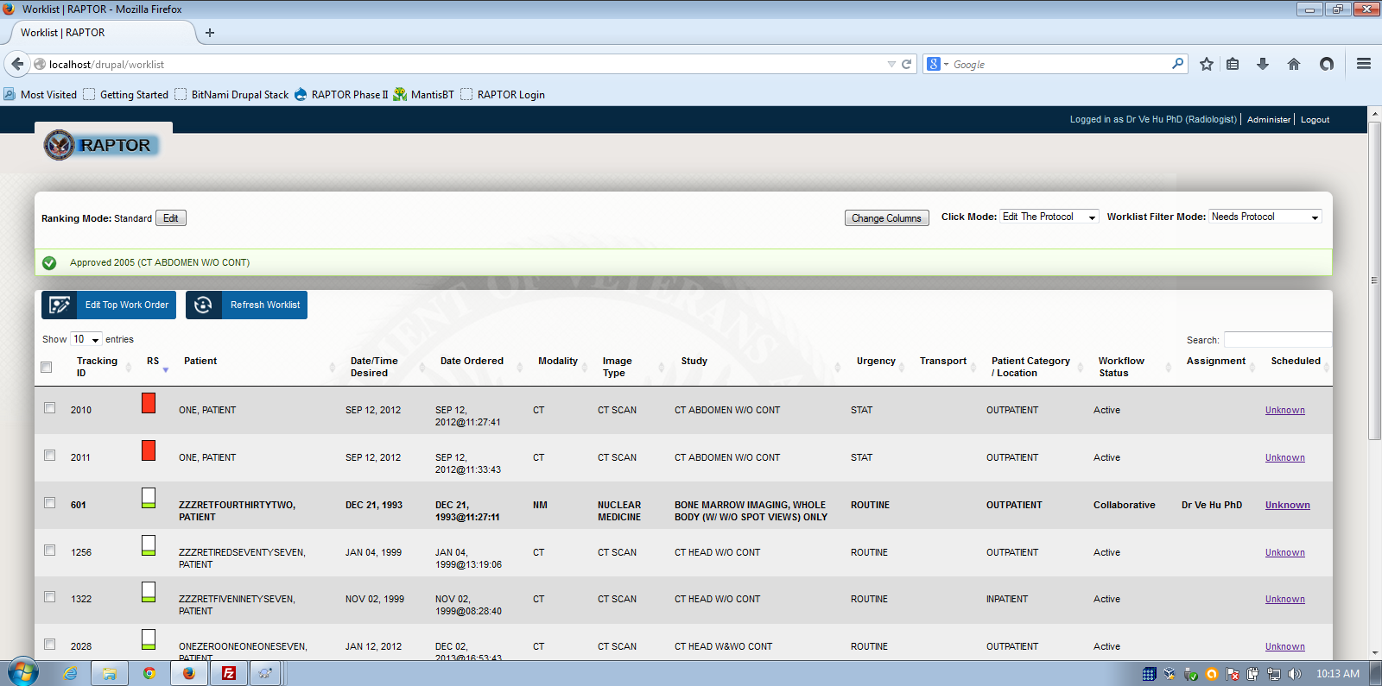
Radiologist Approved Protocol

Slide 45
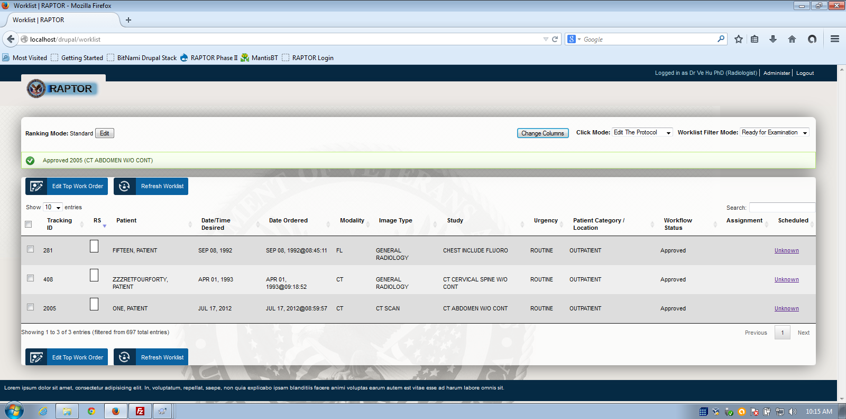
Ready for Examination mode

Slide 46
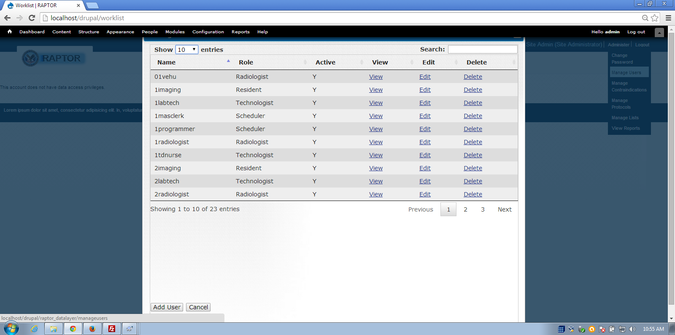

Slide 47
More info
www.sanbusinessconsultants.com
JDI, Medverd, January 2013
SIIM 2012 Conference: Top 5 Medical Imaging IT Projects of 2012
RSNA 2012
Drupal in Government 2012
OSEHRA 2013

